Slide 1
Design Case for a mini-MOOC
On Learning How to Recognize Plagiarism
Association for Educational Communications and Technology
Annual Conference, Indianapolis, IN,
Nov. 5, 2015

Slide 2
Design Case for a mini-MOOC:
Indiana University Online Tutorial and Tests on How to Recognize Plagiarism
Theodore Frick
Cesur Dagli
Rod Myers
  (Further contributors past 14 years: Meltem Albayrak-Karahan, Elizabeth Boling, Joseph Defazio, Muruvvet Demiral Uzan, Funda Ergulec, Retno Hendyranti, Noriko Matsumura, Olgun Sadik, Kei Tomita, Carol Watson, Kyungbin Kwon, Eulho Jung, and others)
Department of Instructional Systems Technology
School of Education, Indiana University Bloomington

Slide 3
Overview
Summary of history of IU Plagiarism Tutorial and Test: 2002 – 2014
Current redesign 2015 – 2016
  Based on First Principles of Instruction (Merrill, 2013), and
  Addresses known issues with current website
Demo of current prototype
  Discussion of design decisions
  Implementation plan

Slide 4
History of IU Plagiarism Tutorial and Test:
2002 - 2014

Slide 5
Initial Tutorial and Test
Requested by IST Department Chair for master’s and doctoral students
Designed and developed in Frick’s advanced production class in IST in spring 2002
Since used as part of new student orientation

Slide 6
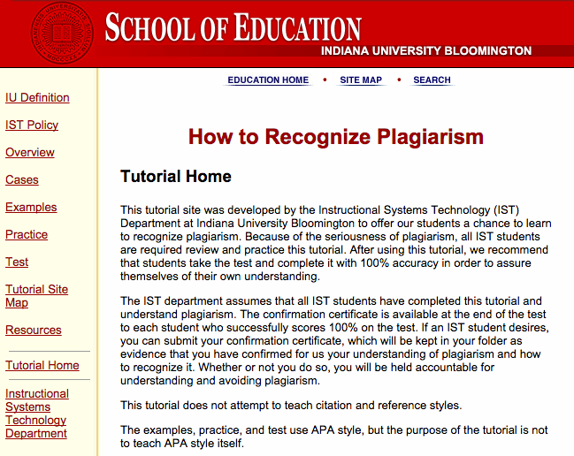
Website in 2003

Slide 7
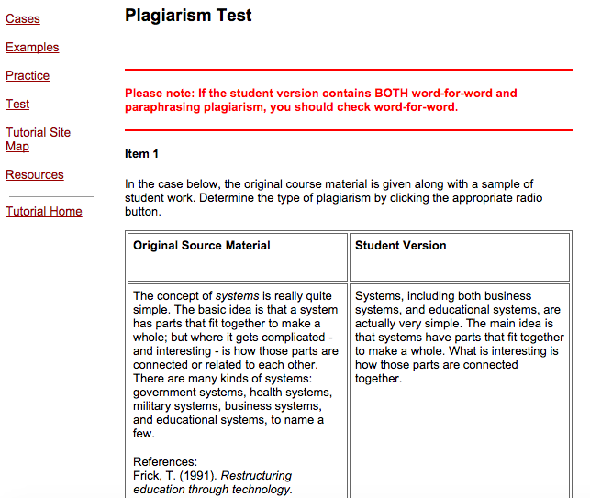
Website in 2003

Slide 8
We did it for ourselves, but …
Other departments at IU started using it
Other universities and schools also started using it—world-wide
No advertising—folks learned about our site via Web search results and word-of-mouth
How to Recognize Plagiarism would now be called a mini-MOOC (Spector, 2014) because it is:
  A Massive Open Online Course
  A freely available online self-contained mini-course on how to recognize plagiarism, available since 2002

Slide 9
Exponential Growth in Usage
* 2015: website requests for first 9 months only. Requests are web page views.

Slide 10
Summary of Major Changes: 2012-2015
Widespread cheating reported by instructors in 2012
Created 2 new very large item pools for:
  Undergrads and advanced HS students
  Master’s and doctoral students
Items selected at random, much harder to cheat
Added practice tests with specific explanatory feedback
Added e-mail of Certificates when a test is passed
Added retrieval and validation of Certificates by students and their instructors

Slide 11
Current Production Website
Latest changes: new registration system and user authentication, implemented Aug. 1:
Usage Aug. 1 – Nov. 1, 2015
  65,000+ successful registrations
  52,000+ Test Certificates issued for passing an Undergrad & Advanced HS test
See: https://www.indiana.edu/~plag/ and recent changes

Slide 12
Major Redesign in Progress
Based on First Principles of Instruction
June 2015 – Present

Slide 13
Need for Changes
Highest priority:
  Many students in 2013-2015 claimed that they never received their Certificates by e-mail after passing a test
  Occasional errors in the computer-adaptive test for graduate students
Success rate for passing a test has been about 15%
  Some students complain that instruction is not sufficient for passing a test
  More effective and efficient instruction is needed to increase student success rate, save them time, and decrease their frustration after not passing a Certification Test.
We want to study the effectiveness of the Plagiarism Tutorial

Slide 14
Recent Changes to Address “Lost” Certificates
Users are now required to register before taking a test.
Optionally answer 4 questions on why they are using the tutorial
Test cannot be taken until user goes to e-mail and clicks on a link to authenticate their registration.

Slide 15
Results of Aug. 1 Changes
94% of registration attempts succeed
Tiny % of users cannot receive e-mail because of service provider filters
  Mostly in K-12 schools
  We now recommend using an e-mail address at Google, Yahoo, etc.
A lot of bounced e-mail!
  Surprising how many users don’t know or mistype their e-mail address.
  100-150 bounces per day during peak usage months.
  Explains why many users never received Certificates in the past—they submitted invalid/unknown e-mail addresses!

Slide 16
Results of Immediate Changes (cont’d)
The predominate reason for use of the tutorial and tests: a required assignment by their instructors.
Many more HS users than we previously thought!
A small number of grad students continue to experience tests not working—note that the Google app server and scripts have not been changed.

Slide 17
Design Resources for New Tutorial
Merrill’s new book on First Principles of Instruction (2013) as a primary resource
First Principles of Instruction:
  Authentic problems/tasks: organized from simple to complex
  Activation: help students connect what they already know with new learning
  Demonstration: provide examples of what is to be learned
  Application: provide practice with explanatory feedback
  Integration: help students incorporate new learning into their personal lives

Slide 18
Design Constraints
Make instruction as parsimonious as possible
  We know from web logs and e-mail comments that user’s primary aim is to pass a Certification Test ASAP
  Because if users fail to pass a test, they use the current tutorial sparingly in order to learn just enough to pass a test.
  Must be flexible and easily navigable so users can be in control.
Design team all volunteers with wide range of design expertise and experience. No budget.
Criteria for the new design implementation:
  Users are not too surprised by changes.
  Maintain good will of target audience—both instructors and students.
  Introduce changes gradually.
  Avoid implementation of major changes during peak usage periods (Aug. – Oct.; Jan. – March; May – June).

Slide 19
Design Goals: Interoperability and Practicality
The new design must be interoperable:
  Must work on various devices including smartphones, tablets, laptops, and desktops.
  Must work with all major Web browsers and adapt gracefully to display constraints.
  Minimize use of JavaScript and external Web servers. Instead use:
    IU servers exclusively, and
    Standard HTML, CSS, and PHP as needed.
  Be structured so that future research studies will be possible—e.g., Analysis of Patterns in Time for determining effectiveness of First Principles.
  Be easy to update in the future.
  Not overload IU servers in high usage periods.

Slide 20
Design Goals:
Content & Design Elements
Carry over as much content and successful design elements from current tutorial to be re-used in new design.
Utilize multi-media as needed to enhance appeal as long as interoperability goals can be met.
Conduct usability tests to improve content and design elements before implementation on the production site.

Slide 21
Discussion of Design Decisions
Prototype online but hidden from public
Demo of current prototype and concurrent discussion of major design decisions for:
  Authentic tasks/problems
  Activation
  Demonstration
  Application
  Integration

Slide 22
Design Challenges & Decisions for First Principles of Instruction
How to create increasingly complex authentic problems?
  Instead of one level in old tutorial, we now have created 10 levels of increasing difficulty.
  Each level consists of: activation, demonstration, application, integration, and a mastery test at that level.
  Show example from current prototype.
  Starting view prototype to illustrate each principle and issues around it.

Slide 23
Design Challenges & Decisions for First Principles of Instruction (cont’d)
What to do about the Activation Principle?
  Since a wide range of users:
    from middle school students to doctoral level students, and
    a wide range of ages (14 – 50),
    provide a common experience for all users.
  Utilize multi-media to make realistic scenarios.
  Include diversity for gender, ethnicity, and some age differences.
  Keep videos short but illustrative of plagiarism cases
  Videos must be clear on small displays such as smart phones and work over slower connections (e.g., wi-fi).
  Required new content design. Done!

Slide 24
Design Challenges & Decisions for First Principles of Instruction (cont’d)
What to do about the Demonstration Principle?
  We have 15 examples of Demonstration in the current tutorial, plus 17 examples of plagiarism patterns.
  However, these are not organized by level of complexity (now 10 levels)
  They are not dynamic demonstrations and require considerable reading and study—hard to focus user attention.
  Plan to do screencasts for each Task Level, which illustrate plagiarism, focus on critical elements, and show how to correct it.
  Requires new content to be designed.

Slide 25
Design Challenges & Decisions for First Principles of Instruction (cont’d)
What to do about the Application Principle?
  Same problem as for Demonstration, practice with feedback not organized by the 10 task levels.
  Decided to make new practice items with explanatory feedback—why it is or isn’t plagiarism.
  Make it interactive—should we use HTML only, or make it dynamic via PHP/AJAX. Undecided for now.
  Include a Mastery Test for each level. Make it isomorphic to Certification tests, but limited to level of complexity.
  This is assessment of student learning, which could be considered Application or Integration, or both. Not sure which or both?
  All of this will include largely new content, not in the current tutorial.

Slide 26
Design Challenges & Decisions for First Principles of Instruction (cont’d)
What to do about the Integration Principle?
  This has been the biggest design challenge, so far!
    Considered a blog for user reflection, discussion, and sharing, but high maintenance costs. Rejected.
    No practical way to judge recognition and avoidance of plagiarism in user’s own life—e.g., for incorporating what is learned in a writing assignment or paper. Rejected.
    Currently plan to incorporate a reflection activity at each level of task difficulty.
      Implement a simple Web form for users to type in a text box.
      No computer judgment and feedback on the reflection task in real time.
      Reflection comments will be stored for later analysis.

Slide 27
Current Status of Design
Incorporate test item pool for graduate students on IU server with structure isomorphic to existing undergraduate test. Huge task. Done late Oct.!
To do:
  Incorporate MOO-TALQ (for Cesur’s research study—see next presentation)
  Conduct usability tests and implement by mid-December (ready for peak usage in Jan. – Feb., 2016).
  Employ temporal mapping to track usage patterns (April?)
  Incorporate adaptive tests (next summer?)

Slide 28
Thank you
Visit the current site:
How to Recognize Plagiarism
https://www.indiana.edu/~plag/
History of Recent Changes
https://www.indiana.edu/~plag/recentChanges.html

